Slide 1
Chapter 24
Credit Risk

Slide 2
Credit Ratings
In the S&P rating system, AAA is the best rating. After that comes AA, A, BBB, BB, B, CCC, CC, and C
The corresponding Moody’s ratings are Aaa, Aa, A, Baa, Ba, B,Caa, Ca, and C
Bonds with ratings of BBB (or Baa) and above are considered to be “investment grade”

Slide 3
Estimating Default Probabilities
Alternatives:
  use historical data
  use credit spreads
  use Merton’s model

Slide 4
Historical Data
Historical data provided by rating agencies are also used to estimate the probability of default

Slide 5
Cumulative Ave Default Rates (%) (1970-2019, S&P, Table 24.1)
 | 1yr | 2yr | 3yr | 4yr | 5yr | 7yr | 10yr | 15yr
AAA | 0.00 | 0.03 | 0.13 | 0.24 | 0.35 | 0.51 | 0.70 | 0.91
AA | 0.02 | 0.06 | 0.12 | 0.21 | 0.31 | 0.50 | 0.72 | 1.02
A | 0.05 | 0.14 | 0.23 | 0.35 | 0.47 | 0.79 | 1.24 | 1.89
BBB | 0.16 | 0.45 | 0.78 | 1.17 | 1.58 | 2.33 | 3.32 | 4.69
BB | 0.61 | 1.92 | 3.48 | 5.05 | 6.52 | 9.01 | 11.78 | 14.67
B | 3.33 | 7.71 | 11.55 | 14.58 | 16.93 | 20.36 | 23.74 | 27.12
CCC/C | 27.08 | 36.64 | 41.41 | 44.10 | 46.19 | 48.26 | 50.38 | 52.59

Slide 6
Interpretation
The table shows the probability of default for companies starting with a particular credit rating
A company with an initial credit rating of BBB has a probability of 0.16% of defaulting by the end of the first year, 0.45% by the end of the second year, and so on

Slide 7
Do Default Probabilities Increase with Time?
For a company that starts with a good credit rating default probabilities tend to increase with time
For a company that starts with a poor credit rating default probabilities tend to decrease with time

Slide 8
Conditional vs Unconditional Default Probabilities
Probability of a CCC bond defaulting during the third year is 41.41− 36.64 = 4.77%
This is an unconditional probability (as seen at time zero)
Probability of a CCC bond defaulting during the third year conditional on no earlier default is 0.0477/0.6336 or 7.53%

Slide 9
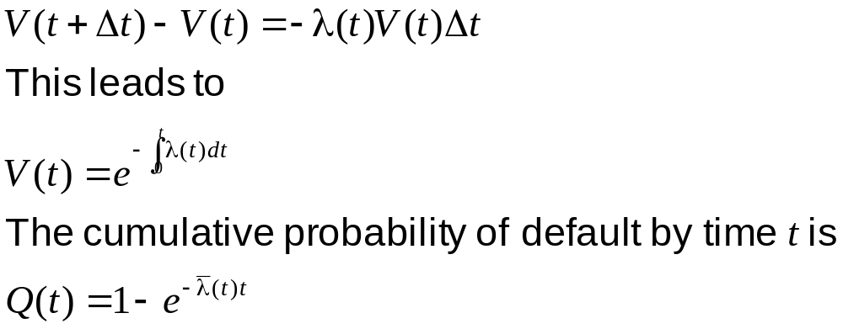
Hazard Rate
The hazard rate (also called default density), λ(t), at time t is defined so that λ(t)Δt is the conditional default probability for a short period between t and t+Δt
If V(t) is the probability of a company surviving to time t

Slide 10
Recovery Rate
The recovery rate for a bond is usually defined as the price of the bond immediately after default as a percent of its face value
Recovery rates tend to decrease as default rates increase

Slide 11
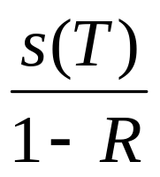
Using Credit Spreads (Equation 24.2)
Suppose s(T) is the credit spread for maturity T
Average hazard rate between time zero and time T is approximately
where R is the recovery rate
This estimate is very accurate in most situations

Slide 12
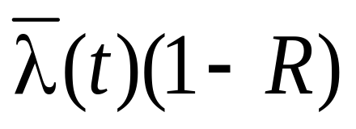
Explanation
Loss rate at time t is λ(t)(1−R)
If the credit spread is compensation for this loss rate it should approximately equal

Slide 13
Matching Bond Prices
For more accuracy we can work forward in time choosing hazard rates that match bond prices
This is another application of the bootstrap method

Slide 14
Real World vs Risk-Neutral Default Probabilities
The default probabilities backed out of bond prices or credit default swap spreads are risk-neutral default probabilities
The default probabilities backed out of historical data are real-world default probabilities

Slide 15
A Comparison
Calculate 7-year default intensities from the historical default probabilities
Estimate default intensities from the credit spreads given by bond yields

Slide 16
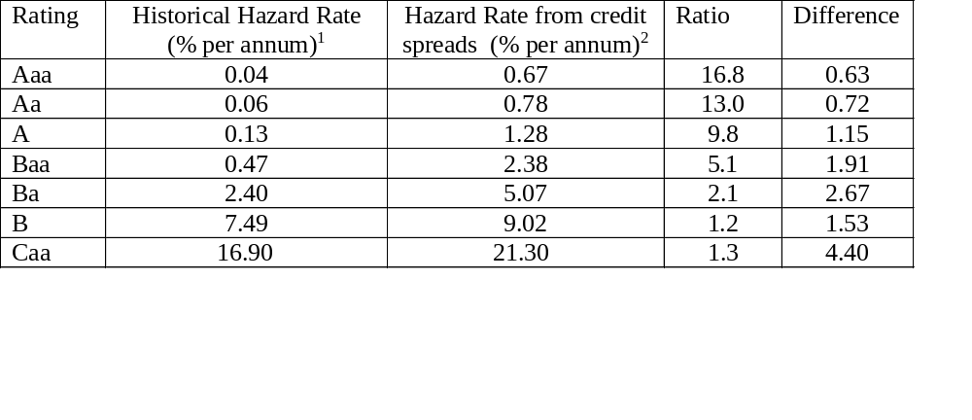
Results published in 2005(Table 24.2)
¹ Calculated as−[ln(1-d)]/7 where d is the historical 7 yr default rate.
² Calculated as s/(1-R) where s is the bond yield spread and R is the recovery rate (assumed to be 40%).

Slide 17
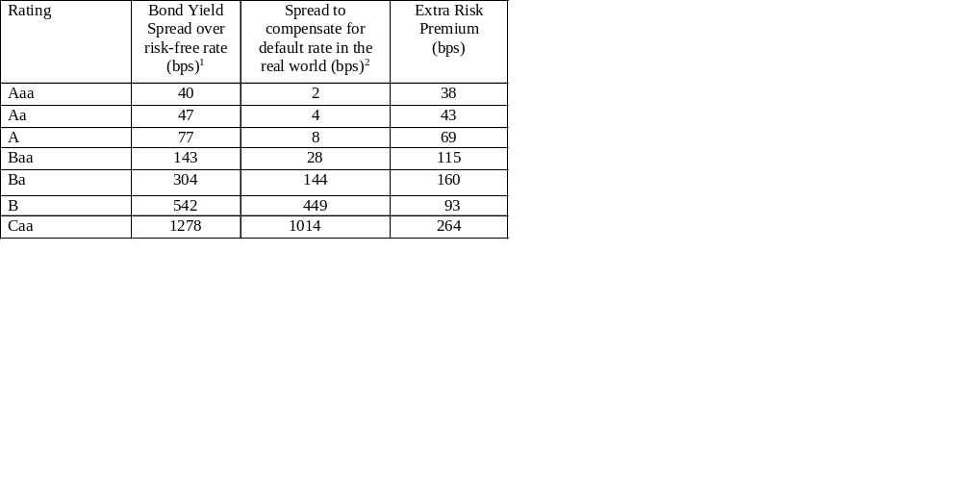
Average Risk Premiums Earned By Bond Traders (Table 24.3)
¹ Equals average spread of bond yield over benchmark risk-free rate (e.g. OIS rate, not theTreasury rate)
² Equals historical hazard rate times (1-R) where R is the recovery rate.

Slide 18
Possible Reasons for the Extra Risk Premium (The third reason is the most important)
Corporate bonds are relatively illiquid
The subjective default probabilities of bond traders may be much higher than the estimates from Moody’s historical data
Bonds do not default independently of each other. This leads to systematic risk that cannot be diversified away.
Bond returns are highly skewed with limited upside. The non-systematic risk is difficult to diversify away and may be priced by the market

Slide 19
Which World Should We Use?
We should use risk-neutral estimates for valuing credit derivatives and estimating the present value of the cost of default
We should use real world estimates for calculating credit VaR and scenario analysis

Slide 20
Using Equity Prices: Merton’s Model
Merton’s model regards the equity as an option on the assets of the firm
In a simple situation the equity value is
max(V_{T} −D, 0)
where V_{T} is the value of the firm and D is the debt repayment required

Slide 21
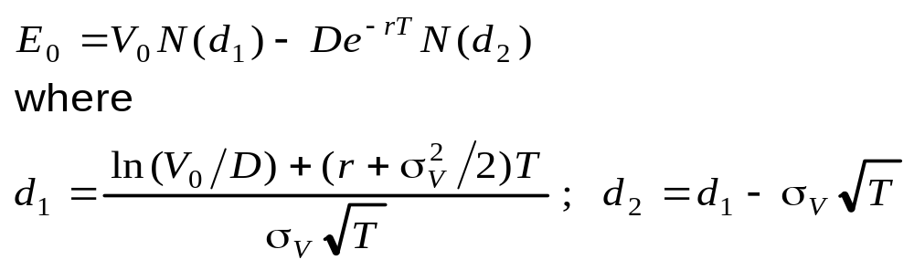
Equity vs. Assets
The Black-Scholes-Merton option pricing model enables the value of the firm’s equity today, E₀, to be related to the value of its assets today, V₀, and the volatility of its assets, σ_{V}

Slide 22
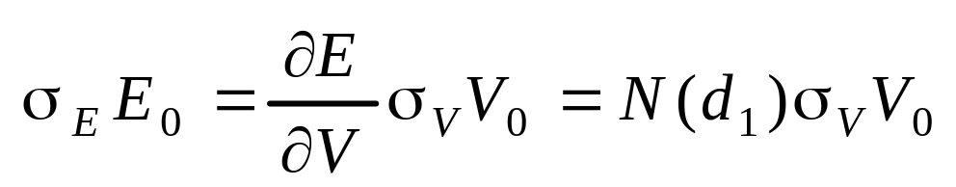
Volatilities
This equation together with the option pricing relationship enables V₀ and σ_{V} to be determined from E₀ and σ_{E}

Slide 23
Example
A company’s equity is $3 million and the volatility of the equity is 80%
The risk-free rate is 5%, the debt is $10 million and time to debt maturity is 1 year
Solving the two equations yields V₀=12.40 and σ_{v}=21.23%
The probability of default is N(−d₂) or 12.7%

Slide 24
The Implementation of Merton’s Model
Choose time horizon
Calculate cumulative obligations to time horizon. This is termed by KMV the “default point”. We denote it by D
Use Merton’s model to calculate a theoretical probability of default
Use historical data or bond data to develop a one-to-one mapping of theoretical probability into either real-world or risk-neutral probability of default.

Slide 25
CVA
Credit value adjustment (CVA) is the amount by which a dealer must reduce the total value of transactions with a counterparty because of counterparty default risk

Slide 26
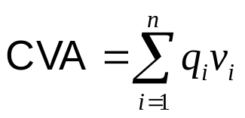
The CVA Calculation
………………
Time
0
t₁
t₂
t₃
t₄
t_{n}=T
………………
Default probability
for counterparty
q₁
q₂
q₃
q₄
q_{n}
………………
PV of expected loss
given default
v₁
v₂
v₃
v₄
v_{n}

Slide 27
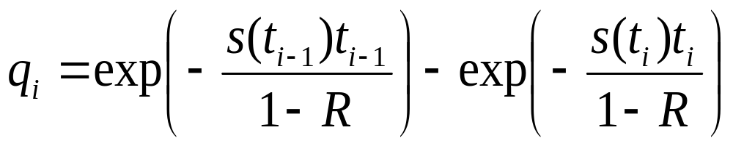
Calculation of q_{i}’s
Default probabilities are calculated from credit spreads

Slide 28
Calculation of v_{i}’s
The v_{i} are calculated by simulating the market variables underlying the portfolio in a risk-neutral world
If no collateral is posted the loss on a particular simulation trial during the ith interval is the PV of (1-R)max(V_{i}, 0) where V_{i} is the value of the portfolio at the mid point of the interval
v_{i} is the average of the losses across all simulation trials

Slide 29
Collateral
It is usually assumed that the collateral is posted as agreed, and returned as agreed, until N days before a default. The N days are referred to as the “cure period” or “margin period at risk.” Usually N is 10 or 20.
Suppose that that a portfolio is fully collateralized with no initial margin and its value moves in favor of the dealer during the cure period. Then v_{i} is positive because
  If the portfolio has a positive value to the dealer at the default time, collateral posted by the counterparty is insufficient
  If the portfolio has a negative value to the dealer at the default time, excess collateral posted by the dealer will not be returned

Slide 30
Incremental CVA
Results from Monte Carlo are stored so that the incremental impact of a new trade can be calculated without simulating all the other trades.

Slide 31
CVA Risk
The CVA for a counterparty can be regarded as a complex derivative
Increasingly, dealers are managing it like any other derivative
Two sources of risk:
  Changes in counterparty spreads
  Changes in market variables underlying the portfolio

Slide 32
Wrong Way/Right Way Risk
Simplest assumption is that probability of default q_{i} is independent of net exposure v_{i}.
Wrong-way risk occurs when q_{i} is positively dependent on v_{i}
Right-way risk occurs when q_{i} is negatively dependent on v_{i}

Slide 33
DVA
Debit (or debt) value adjustment (DVA) is an estimate of the cost to the counterparty of a default by the dealer
Same formulas apply except that v is counterparty’s loss given a dealer default and q is dealer’s probability of default
Value of transactions with counterparty = No default value – CVA + DVA

Slide 34
DVA continued
What happens to the reported value of transactions as dealer’s credit spread increases?

Slide 35
Credit Risk Mitigation
Netting
Collateralization
Downgrade triggers

Slide 36
Simple Situation
Suppose portfolio with a counterparty consists of a single uncollateralized transaction that always has a positive value to the dealer and provides a payoff at time T
The CVA adjustment has the effect of multiplying the value of the transaction by e^{-s(T)T} where s(T) is the counterparty’s credit spread for maturity T

Slide 37
Example 24.5
A 2-year uncollateralized option sold by a new counterparty to the dealer has a Black-Scholes-Merton value of $3
Assume a 2 year zero coupon bond issued by the counterparty has a yield of 1.5% greater than the risk free rate
If there is no collateral and there are no other transactions between the parties, value of option is 3e^{-0.015×2}=2.91

Slide 38
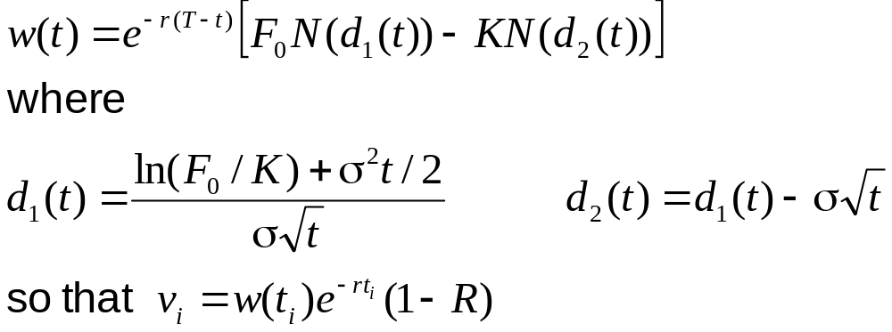
Uncollateralized Long Forward with Counterparty
For a long forward contract that matures at time T the expected exposure at time t is
where F₀ is the forward price today, K is the delivery price, σ is the volatility of the forward price, Τ is the time to maturity of the forward contract, and r is the risk-free rate

Slide 39
Example 24.6
2 year forward. Current forward price is $1,600 per ounce. Two one-year intervals
K = 1,500, σ = 20%, R = 0.3, r = 5%
t₁ =0.5, t₂=1.5
Suppose q₁ =0.02 and q₂=0.03
v₁ = 92.67 and v₂ = 130.65
CVA=0.02×92.67+0.03×130.65 = 5.77
Value after CVA =
(1600−1500)e^{-0.05×2} − 5.77 = 84.71

Slide 40
Default Correlation
The credit default correlation between two companies is a measure of their tendency to default at about the same time
Default correlation is important in risk management when analyzing the benefits of credit risk diversification
It is also important in the valuation of some credit derivatives, eg a first-to-default CDS and CDO tranches.

Slide 41
Measurement
There is no generally accepted measure of default correlation
Default correlation is a more complex phenomenon than the correlation between two random variables

Slide 42
Survival Time Correlation
Define t_{i} as the time to default for company i and Q_{i}(t_{i}) as the cumulative probability distribution for t_{i}
The default correlation between companies i and j can be defined as the correlation between t_{i} and t_{j}
But this does not uniquely define the joint probability distribution of default times

Slide 43
The Gaussian Copula Model
-0.2
0
0.2
0.4
0.6
0.8
1
1.2
-0.2
0
0.2
0.4
V
0.6
0.8
1
1.2
V
V
V
2
1
2
1
One
One
-
-
to
to
-
-
one
one
mappings
mappings
-6
-6
-4
-4
-2
-2
0
0
2
2
4
4
6
6
-6
-6
-4
-4
-2
-2
0
0
2
2
4
4
6
U
6
U
2
U
2
U
1
1
Correlation
Correlation
Assumption
Assumption

Slide 44
Gaussian Copula Model continued
Define a one-to-one correspondence between the time to default, t_{i}, of company i and a variable x_{i} by
Q_{i}(t_{i} ) = N(x_{i} ) or x_{i} = N⁻¹[Q(t_{i})]
where N is the cumulative normal distribution function.
This is a “percentile to percentile” transformation. The p percentile point of the Q_{i} distribution is transformed to the p percentile point of the x_{i} distribution. x_{i} has a standard normal distribution
We assume that the x_{i} are multivariate normal. The default correlation measure, ρ_{ij} between companies i and j is the correlation between x_{i} and x_{j}

Slide 45
Example of Use of Gaussian Copula (Example 24.7)
Suppose that we wish to simulate the defaults for n companies . For each company the cumulative probabilities of default during the next 1, 2, 3, 4, and 5 years are 1%, 3%, 6%, 10%, and 15%, respectively

Slide 46
Use of Gaussian Copula continued
We sample from a multivariate normal distribution (with appropriate correlations) to get the x_{i}
Critical values of x_{i} are
N ⁻¹(0.01) = -2.33, N ⁻¹(0.03) = -1.88,
N ⁻¹(0.06) = -1.55, N ⁻¹(0.10) = -1.28,
N ⁻¹(0.15) = -1.04

Slide 47
Use of Gaussian Copula continued
When sample for a company is less than
-2.33, the company defaults in the first year
When sample is between -2.33 and -1.88, the company defaults in the second year
When sample is between -1.88 and -1.55, the company defaults in the third year
When sample is between -1,55 and -1.28, the company defaults in the fourth year
When sample is between -1.28 and -1.04, the company defaults during the fifth year
When sample is greater than -1.04, there is no default during the first five years

Slide 48
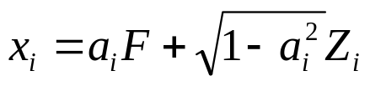
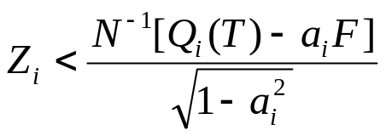
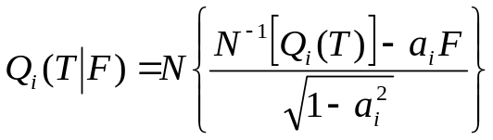
A One-Factor Model for the Correlation Structure
The correlation between x_{i} and x_{j} is a_{i}a_{j}
The ith company defaults by time T when x_{i} < N⁻¹[Q_{i}(T)] or
Conditional on F the probability of this is

Slide 49
Credit VaR
Can be defined analogously to Market Risk VaR
A T-year credit VaR with an X% confidence is the loss level that we are X% confident will not be exceeded over T years

Slide 50

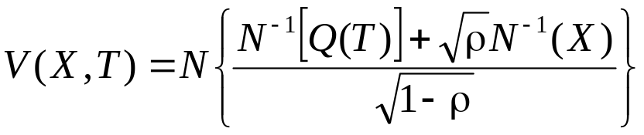
Calculation from a Factor-Based Gaussian Copula Model (equation 24.10)
Consider a large portfolio of loans, each of which has a probability of Q(T) of defaulting by time T. Suppose that all pairwise copula correlations are ρ so that all a_{i}’s are
We are X% certain that F is less than
N⁻¹(1−X) = −N⁻¹(X)
It follows that the VaR is

Slide 51
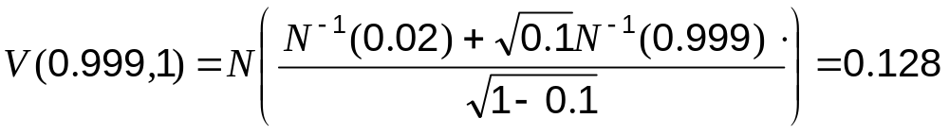
Example 24.8
A bank has $100 million of retail exposures
1-year probability of default averages 2% and the recovery rate averages 60%
The copula correlation parameter is 0.1
99.9% worst case default rate is
The one-year 99.9% credit VaR is therefore 100×0.128×(1-0.6) or $5.13 million

Slide 52
CreditMetrics
Calculates credit VaR by considering possible rating transitions
A Gaussian copula model is used to define the correlation between the ratings transitions of different companies

